Slide 1
Backpacking with Your Dog!

Slide 2
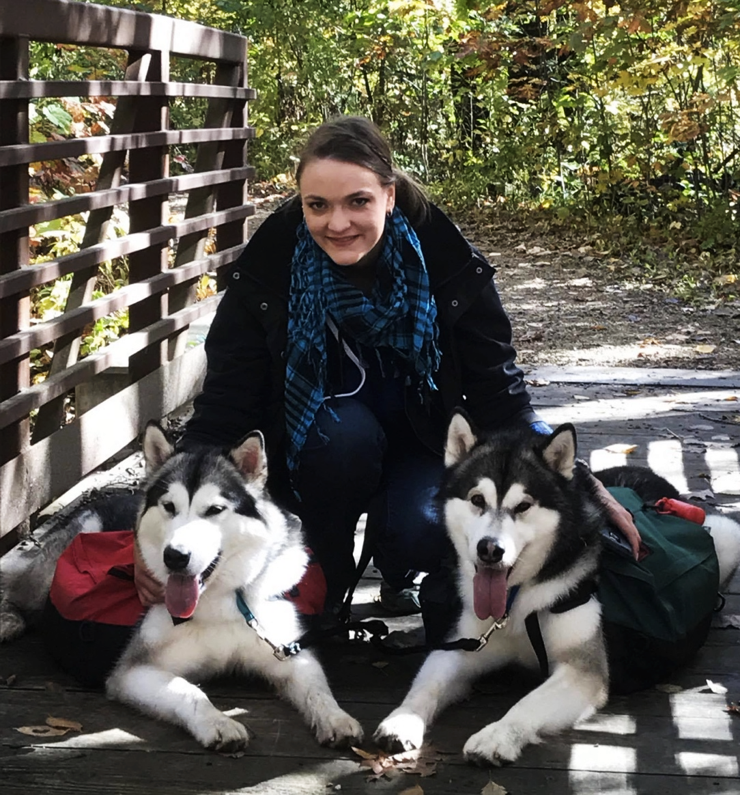
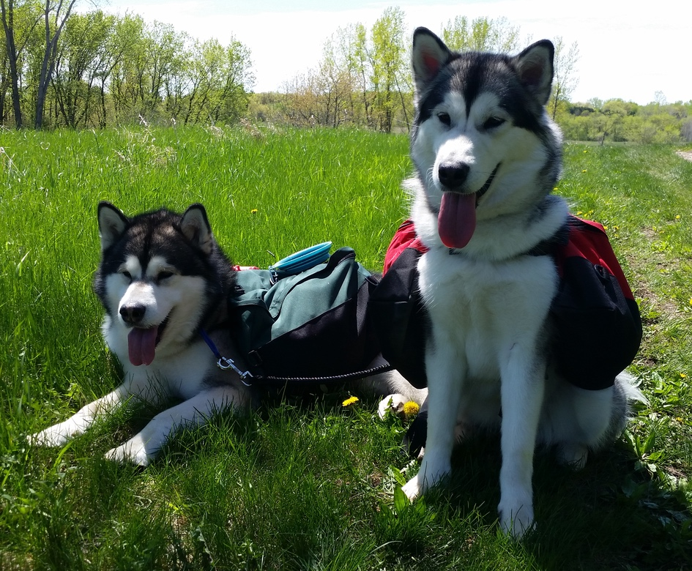
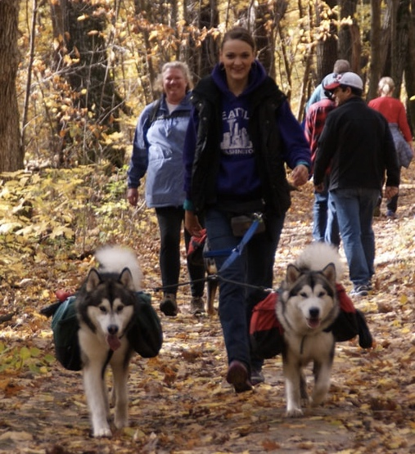
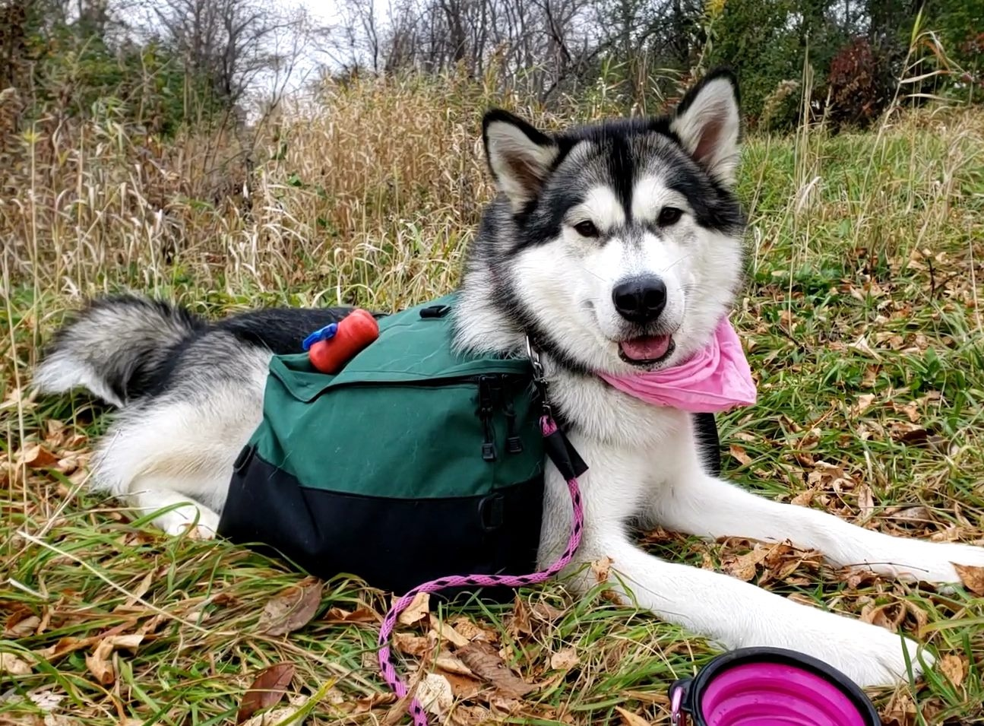
Background:
Vesta
Nero
Me:
Recreational hiker
Day trips
5-10 miles
My Dogs:
Nero (7 years old)
Vesta (5 years old)
Psyche (2 years old)
All of my dogs earn backpacking titles
Psyche

Slide 3
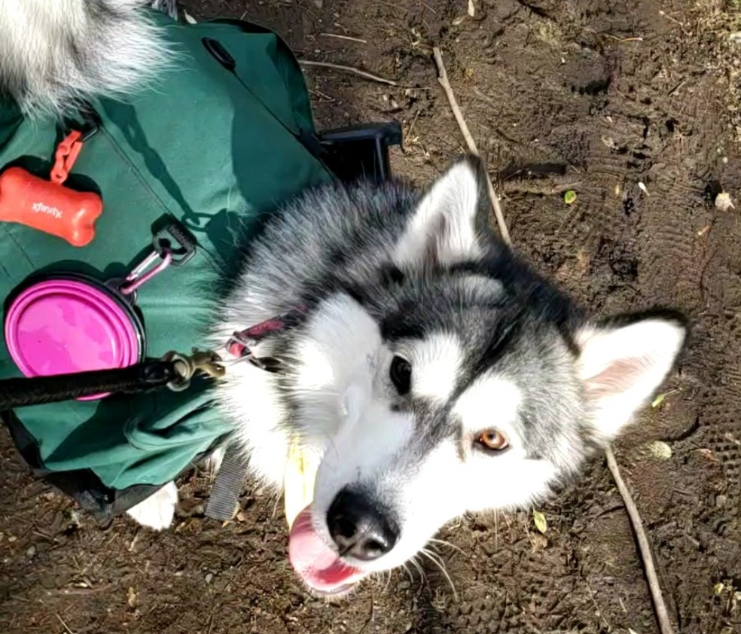
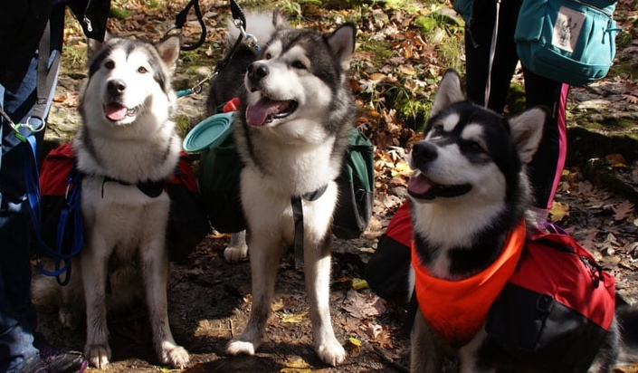
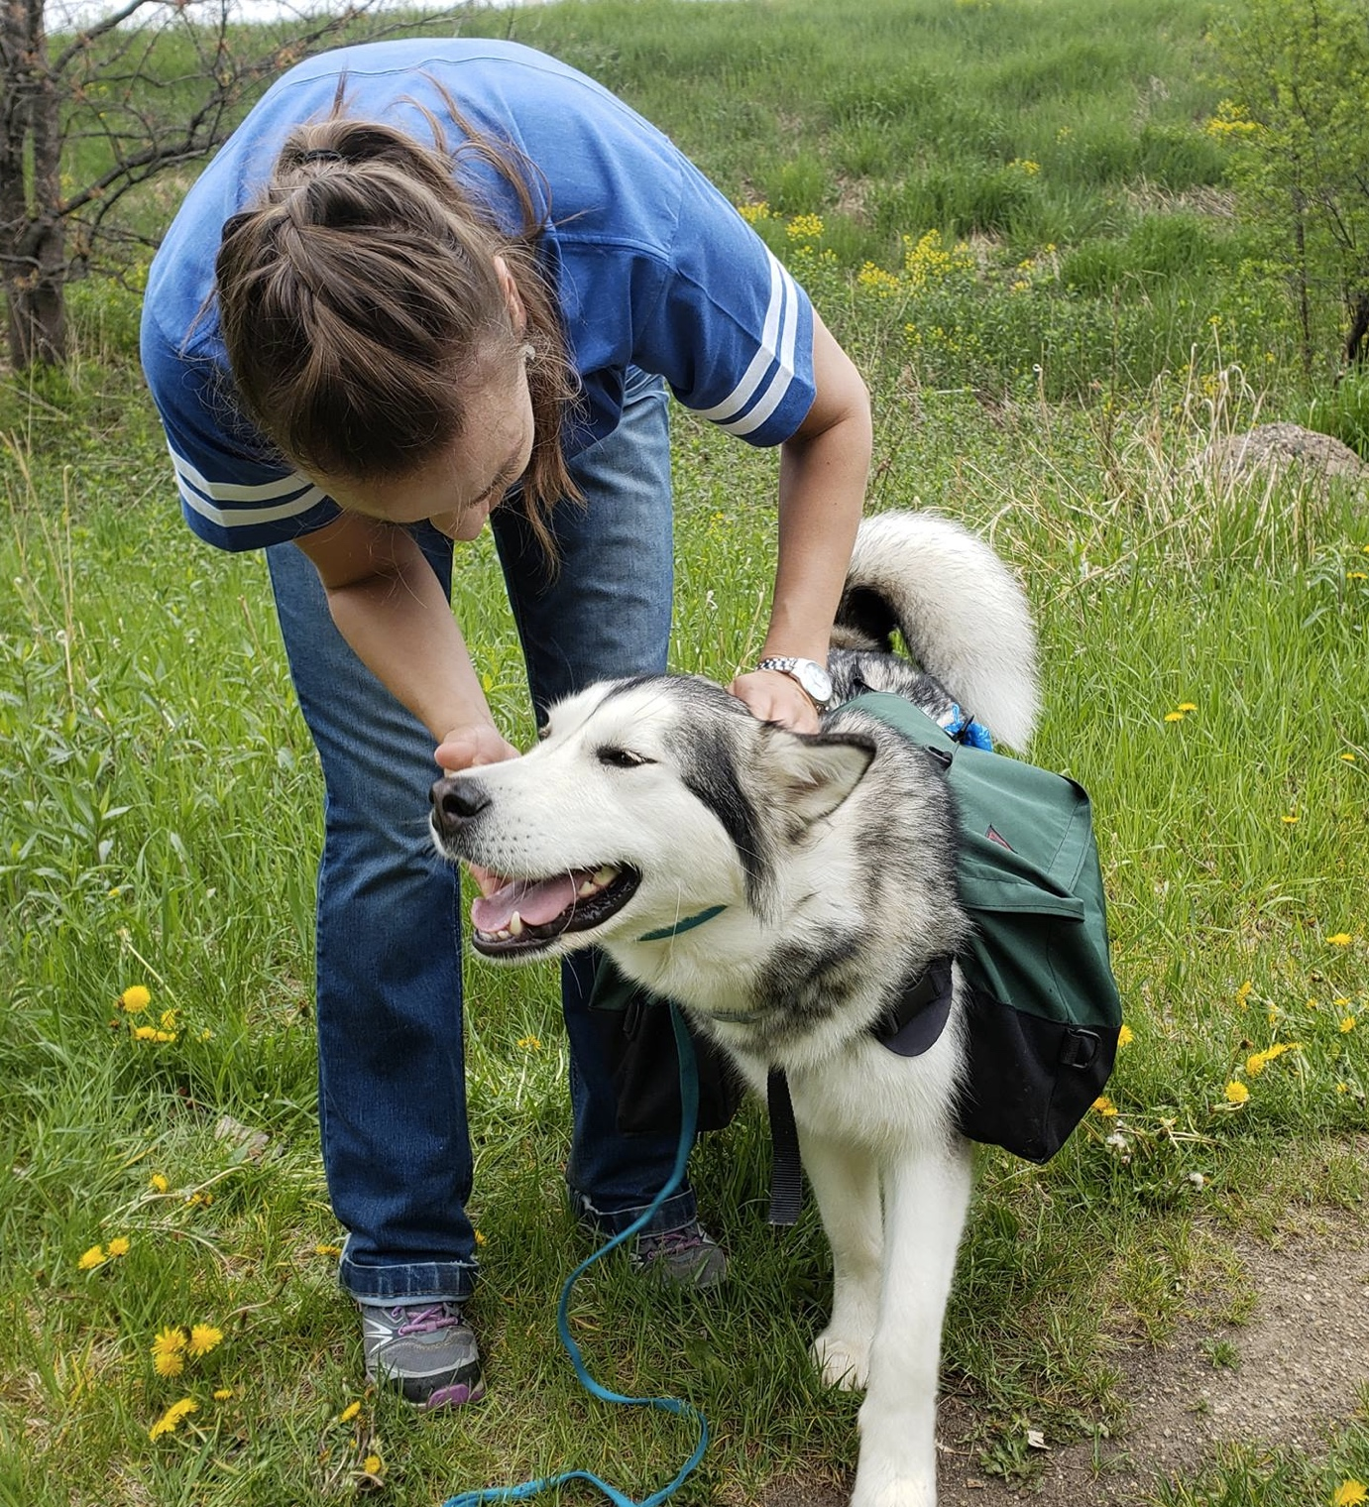
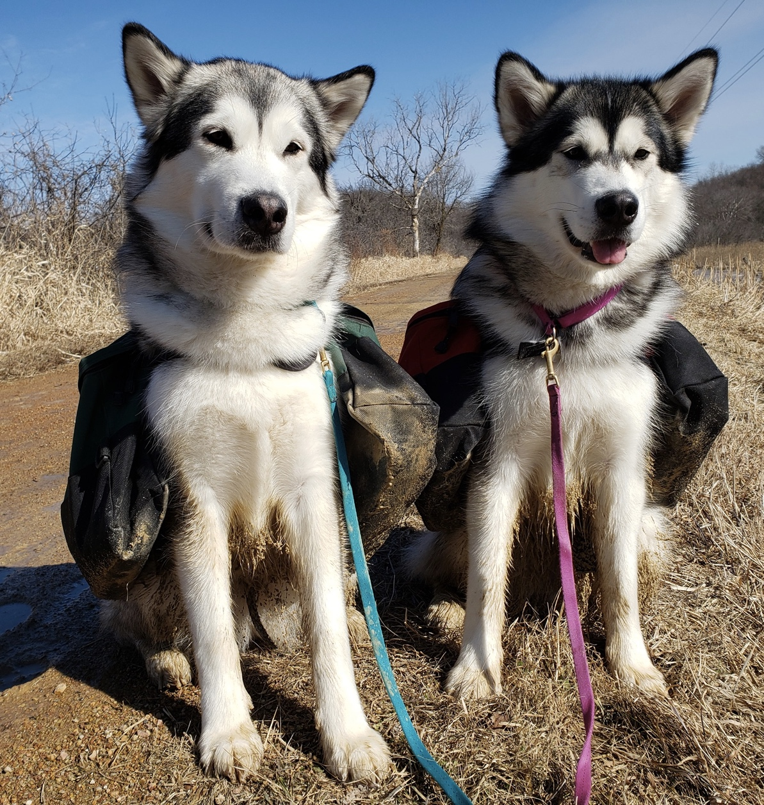
Why Backpack with Your Dog?
Disclaimer: It doesn’t matter what breed!
Packs come in many sizes
Why:
Gives your dog a job – more focused, less pulling
You don’t have to carry everything!
Exercise will ’pack’ more of a punch for your dog

Slide 4
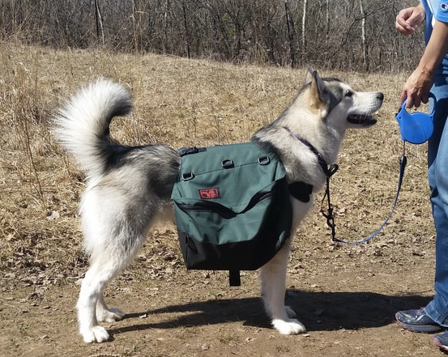
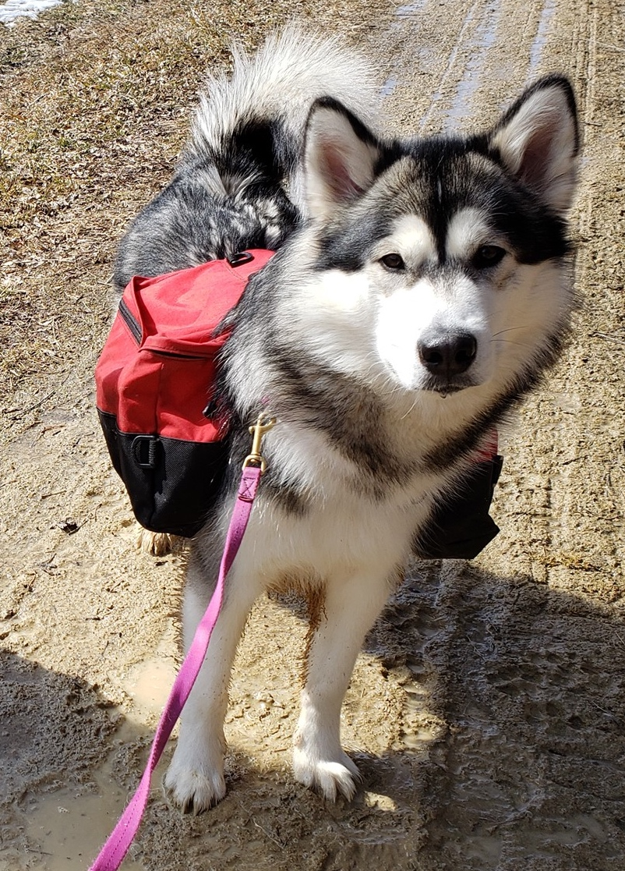
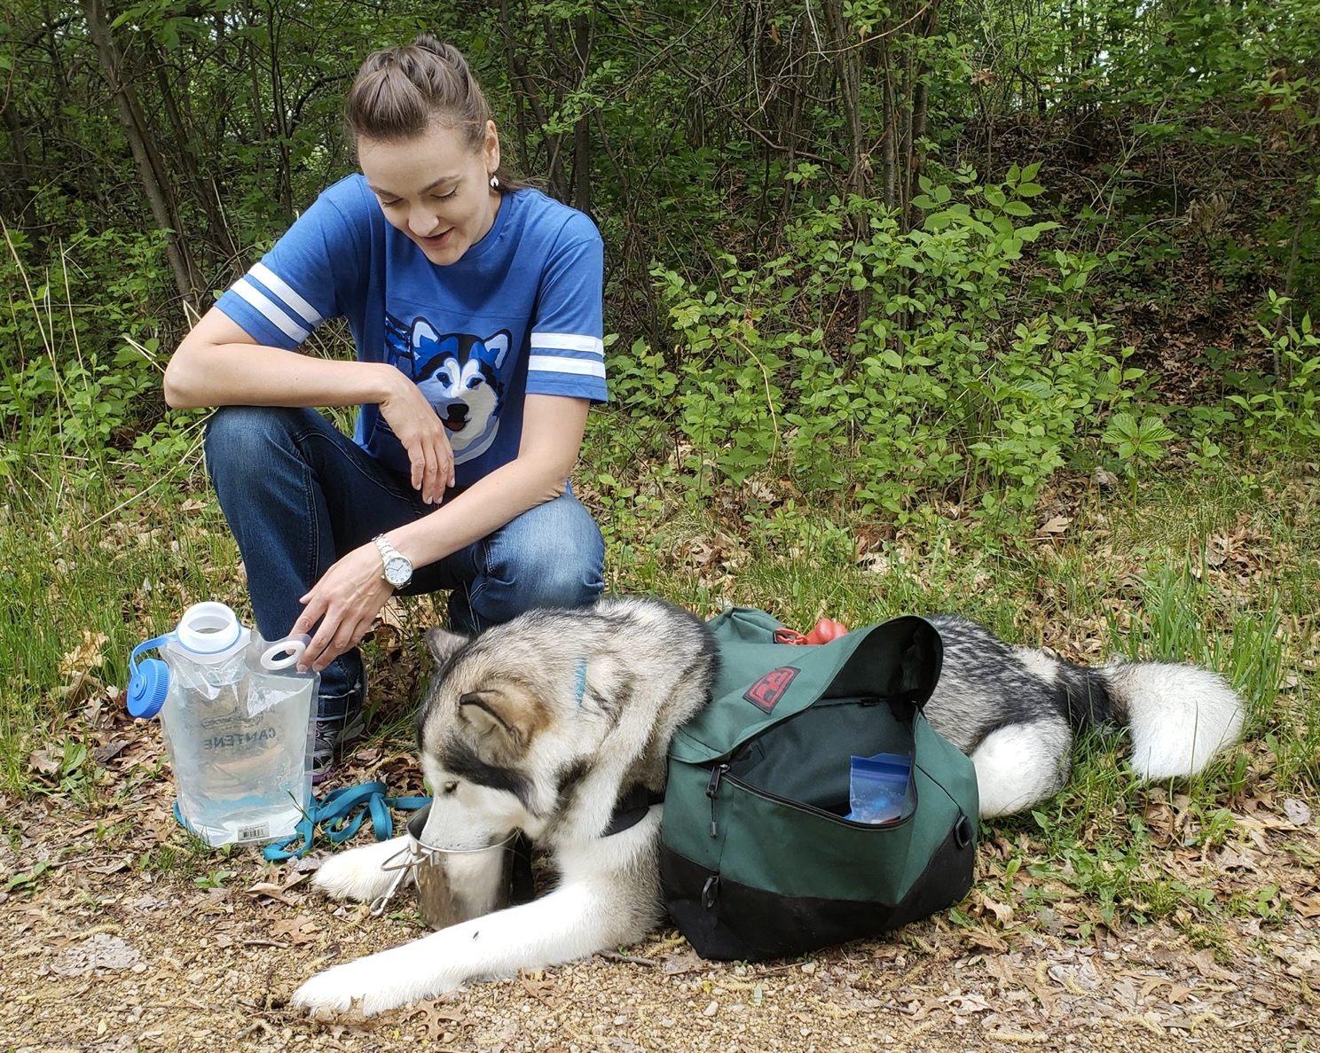
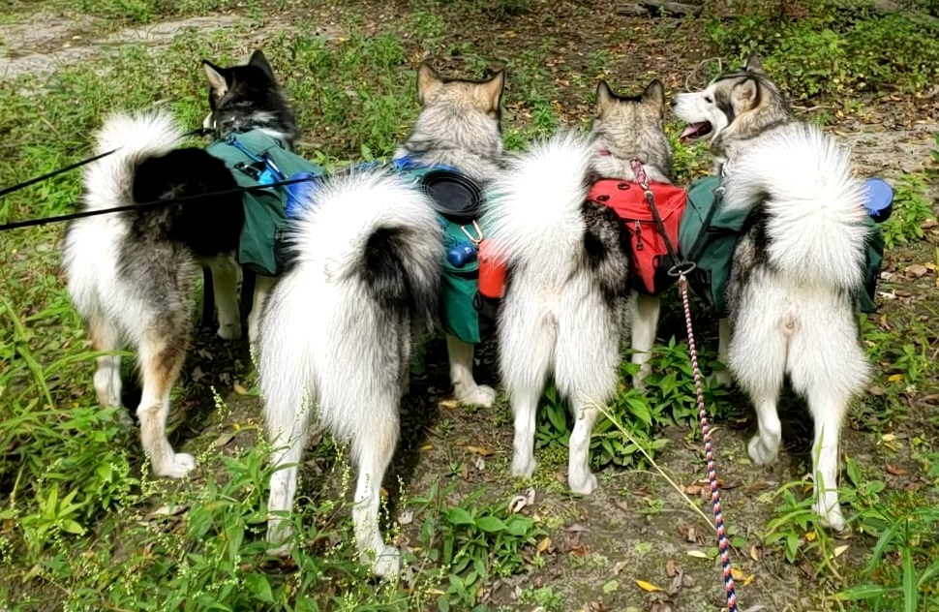
How to Backpack with Your Dog
Make sure your dog is in good health!
The Pack
Wenaha, Ruffwear, Outward Hound
Should sit on shoulders, not the back
Start with something bulky yet light (e.g. rolled up towels) to acclimate them to the extra width, sound, and sensation
Gradually increase weight over time – don’t go too fast!
Always backpack on natural surfaces

Slide 5
Hiking Supplies
1
11
The Dog!
Dog backpack
Collapsible Water Bowl
Doo Tube
Poop bags
Orange/pink bandana
Pet Corrector
My backpack
Microfiber Towel
Hand Sanitizer
Mosquito Deterrent
Umbrella
Kleenex
Garmin/GPS
Foldable Hat
First Aid Kit
Collapsible Hiking Stick
Not Pictured: dog treats skijoring belt, water bottle, Pedialyte, snacks, water shoes
8
6
3
5
7
5
4
2
9
10
11
17
16
14
12
13
15

Slide 6
Happy Hiking!
And ALWAYS leash your dogs.

